Slide 1
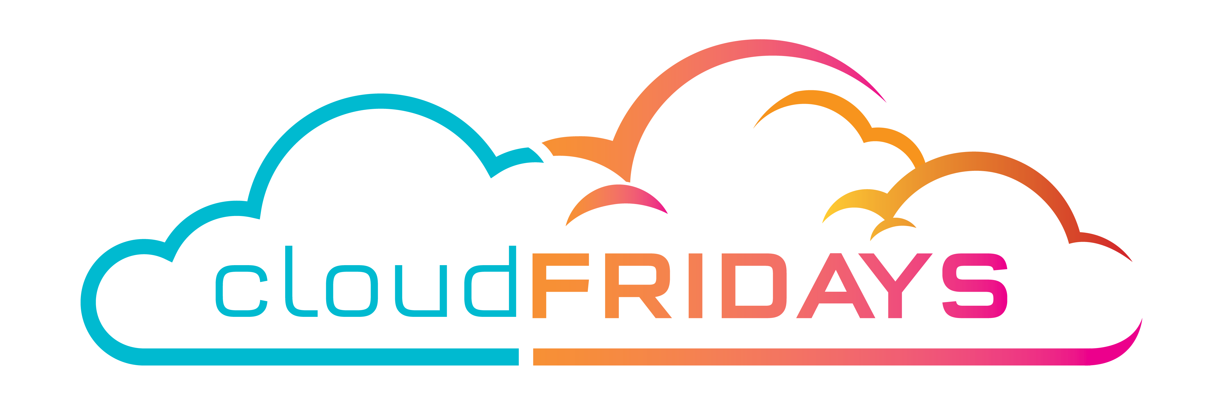

Beyond lift and Shift to Innovation - Modernizing Applications
Warren du Toit

Slide 2
Agenda
Azure Application Platform & Architecture
App Modernization using App Service
App Modernization using Containers, Microservices and Service Fabric
Azure Dev Ops

Slide 3
Azure Application Platform & Architecture

Slide 4

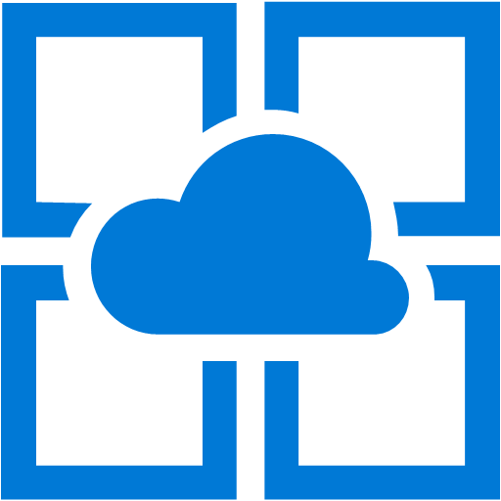
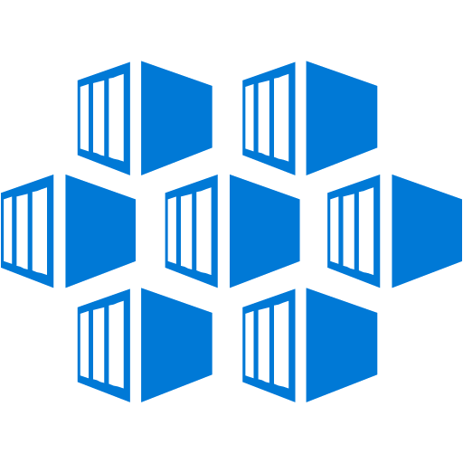

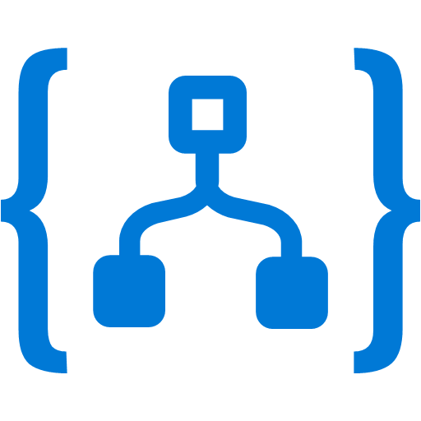
Cloud Migration Strategies
Migration path with the right approach depending on fit with your goals
Rehost
Refactor
Rearchitect
Rebuild
On-Premises
Infrastructure Platform
“Lift and shift”. No-code option
Repackaging. Minimal code changes
Modify or extend existing code to optimize for cloud scale
Rebuild app from scratch using cloud native technology
Less strategic
More Business critical
Azure IaaS VMs
App Service
Azure Container Service (AKS)
Azure Functions and Logic Apps
Notes:
Source: https://www.gartner.com/smarterwithgartner/7-options-to-modernize-legacy-systems/
Acronyms
IaaS: Infrastructure as a Service
PaaS: Platform as a Service

Slide 5



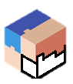
Modernize applications
Containerize
Modernize
Decompose
Transformed
Traditional application
Hosted as guest executables or containers in Service Fabric
Modernization by adding new microservices
Innovate by decomposing application into microservices
Transformed into microservices or new greenfield application
…You can stop at any stage

Slide 6
Cloud development
When moving from offline to online and developing services, you need to…
Be prepared for failures
Understand that scale can be unpredictable
Managing services is often harder than building services and having operational telemetry for visibility
Care upfront about security
Developer productivity
Prepare to be agile
A preferred approach is to use a microservices design

Slide 7
Microservice architecture benefits
Scale Independently
Different Technology Stacks
Photo Share Service
Thumbnail Service
Photo Share Service node.js
Thumbnail Service .NET
Photo Share Service
Thumbnail Service
Photo Share Service
Thumbnail Service
Photo Share Service
Independent Deployments
Photo Share Service V1
Thumbnail Service V2
Thumbnail Service V1
http://aka.ms/servicefabricdocs and https://aka.ms/microservicesebook

Slide 8
Microservices platform
Build applications with multiple frameworks, containers and languages
Microservices Platform
Deploy and manage applications to many environments

Slide 9
App Modernization using App Service

Slide 10
Azure App Service
Enterprise-grade apps
Fully managed platform
High productivity development
Global data center footprint
Hybrid support
Built-in auto scale and load balancing
High availability with auto-patching
Docker, .NET, Java, PHP,
Node, Ruby, and Python
Staging and deployment
AAD integrated
Secure + compliant
Reduced operations costs
Backup and recovery
Testing in production
App gallery marketplace

Slide 11
App Service Features & Capabilities
All features and capabilities are shared across all of App Service application (Web, Mobile, and API)
Enterprise grade
Designed for secure mission-critical applications
Fully managed
Optimized for Availability and Automatic scale
High productivity
Premium Tier
App Service Environments
Hybrid Connections / VPN Support
Scheduled Backup
Azure Active Directory Integration
Site Resiliency, HA, and DR
Web Jobs
Role Base Access Control
Audit / Compliance
Enterprise Migration
Client Certs
Redis Caching
IP Restrictions/ SSL
Web Sockets
SQL, MySQL, DocDB, & Mongo
OS & Framework Patching
Automated Deployment AutoScale
Built-in Load Balancing
WW Datacenter Coverage
End Point Monitoring & Alerts
DR Site Support
WildCard Support
Dedicated IP address
HTTP Compression
WebJobs
Premium WordPress
Sticky Sessions
App Service Environment
Remote Debugging w/ Visual Studio
Site Staging Slots
Traffic Routing
Continuous Integration/Deployment
Git, Visual Studio Online and GitHub
App & Site Diagnostics
Site Extensions Gallery
NET, PHP, Python, Node, Java
Framework Installer
Browser-based editing
Auto-Healing
Logging and Auditing
Admin-Site
Support Site Extension
Notes:
And customers are using some of these features
This is a partial feature list and we are not going to cover each and every feature.
However, I do want to point that we have relapsed 21new public facing features in the past 12 months. at a rate more than 2 features per month….
We plan to continue this pace and even accelerate it to provide more value and innovation to our customers
Hybrid Connections / VPN Support
Scheduled Backup
Azure Active Directory Integration
Site Resiliency, HA, and DR
Web Jobs
Role Base Access Control
Audit / Compliance
Enterprise Migration
Client Certs
Cache
IP Restrictions/ SSL
Web Sockets
SQL, MySQL, DocDB, & Mongo
Sticky Sessions
Authorization/ Authentication
Automated Deployment AutoScale
Built-in Load Balancing
WW Datacenter Coverage
End Point Monitoring & Alerts
App Gallery
DR Site Support
WildCard Support
Dedicated IP address
HTTP Compression
CDN Support for Websites
Premium WordPress
App Services Environments
Remote Debugging with Visual Studio
Site Staging Slots
Testing in Production
Continuous Integration/Deployment
Git, Visual Studio Online and GitHub
App & Site Diagnostics
OS & Framework Patching
Site Extensions Gallery
NET, PHP, Python, Node, Java
Framework Installer
Browser-based editing
Auto-Healing
Logging and Auditing
Admin-Site
Support Site Extension

Slide 12






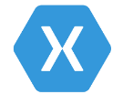
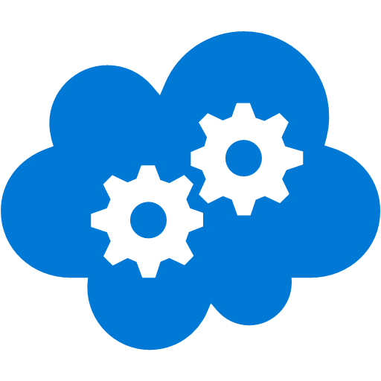


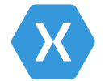

App Service
Media services
Structured
Document database
Logging
Storage
Customer browser
CDN
Branded website
CMS
Functions
Power BI
with personalized experience and mobile notifications
Xbox TV integration
Twilio
Notification Hubs
Functions
Application insights
LUIS
Emotion API
Bot integration
App Service
Bot Service
Cognitive Services
AD B2C
Customer mobile
Weather service
Xamarin Test Cloud
Visual Studio Team Services
Xamarin
Visual Studio

Slide 13


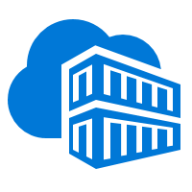


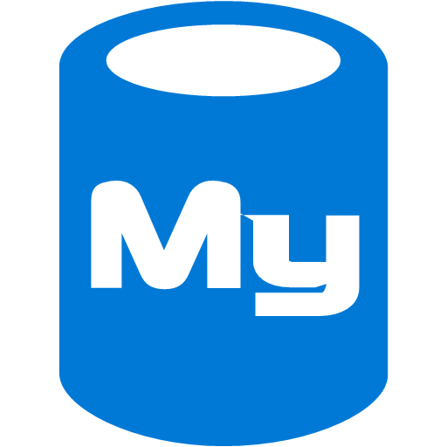

VS code
GitHub repository
Azure Container Repository
Web App for Containers
Local Git repository
Kudu
Developers
Web App for Containers
MySQL database
Monitoring log aggregation
CDN
End users

Slide 14



Host on an App Service Plan
App Service Plan
S1 instance
S1 instance
app
app
app
app
app
app
Price tier: Standard
Compute Resource: S1
Scale: 2
Apps: running 3 apps
Real VM
Real VM
Notes:
S1 = Standard and 1 is size of the VM. For App Service A1 a small VM (1 core 1.6 GB)

Slide 15
Scale-Up
App Service Plan
S2 instance
S2 instance
app
app
app
app
app
app
Price tier: Standard
Compute Resource: S2
Scale: 2
Apps: running 3 apps
Real VM
Real VM
Notes:
S1 = Standard and 1 is size of the VM. For App Service A1 a small VM (1 core 1.6 GB)

Slide 16
Scale-Out
Price tier: Standard
Compute Resource: S2
Scale: 3
Apps: running 3 apps
App Service Plan
S2 instance
S2 instance
S2 instance
app
app
app
app
app
app
app
app
app
Real VM
Real VM
Real VM
Notes:
S1 = Standard and 1 is size of the VM. For App Service A1 a small VM (1 core 1.6 GB)

Slide 17
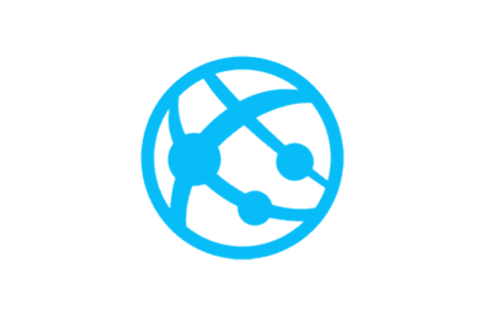
App Service networking features
To your app
From your app
Default
Shared inbound IP <appname>.azurewebsites.net
Default
Access only internet addressable IPs
App assigned IP address
Public IP address only used by your app
VNet Integration
Access Azure Virtual Network private IPs
IP Restrictions
Restrict access to your app at an IP level
Hybrid Connections
Access TCP endpoints in any network
ILB App Service Environment
Private IP address in your Azure Virtual Network
App Service Environment
Operate in a customer controlled network

Slide 18
Default App Service networking behavior
App Service
Inbound traffic to your app hits an IP address that is shared with the other apps.
Outbound backend calls from your app can only go out to the internet through a set of addresses shared with other apps.
Internet

Slide 19
App assigned address
App Service
Inbound traffic to your app hits a dedicated IP address that is used just by your app.
Outbound backend calls from your app still go out to the internet through a set of addresses shared with other apps.
Internet

Slide 20


VNet Integration
App Service
Azure Virtual Network
Internet
Outbound backend calls from your app can go to private IP addresses in your Azure Virtual Network or go out to the internet through a set of addresses shared with other apps.

Slide 21
Hybrid Connections
Network A
Outbound backend calls from your app can go to specific TCP endpoints (host:port) in your any network that can access the internet, or go out to the internet through a set of addresses shared with other apps.
Network B
Internet
App Service
Network C

Slide 22


App Service Environment (ASE)
The apps in an ASE are exposed to the internet through a VIP
Because the apps are inside your VNet, they can access resources that are in the same virtual network without additional configuration.
If the VNet is connected to an on premises network via a Site to Site or ExpressRoute VPN then they can access resources on premises
If you want private site access then create an ILB ASE which uses an Internal Load Balancer instead of one with an external VIP
An ASE is a deployment of the Azure App Service into a subnet in a customer’s Azure Virtual Network (VNet)
Internet
Azure Virtual Network
VIP
On Premises
App Service Environment
Site to Site or ExpressRoute VPN

Slide 23


Multi-tier app on ASE with WAF
Expose your front end apps through a WAF device for greater security.
App Service Environment
Internet
Host your second tier API applications on the same ILB ASE. Because the traffic between the web and API apps stays in the VNet you have a secure multi-tier hosting platform that only exposes what you want.
WAF
web apps
ILB
API apps
Azure Virtual Network

Slide 24
App Modernization using Containers, Microservices and Service Fabric

Slide 25
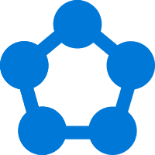


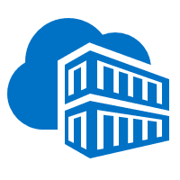

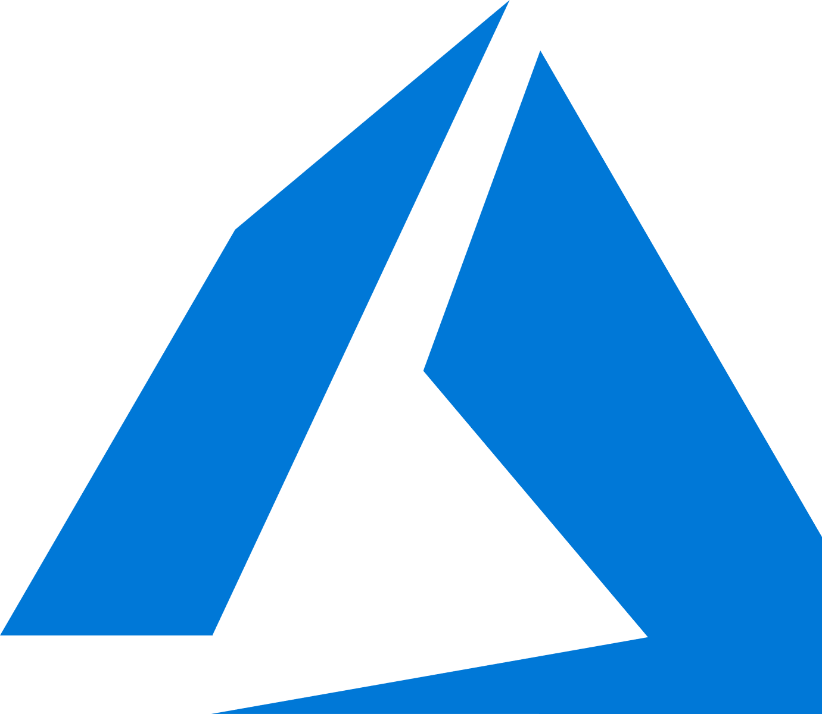


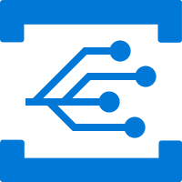

Powering Azure and Microsoft services
Service Fabric is designed for mission-critical services
Azure Database for MySQL
SQL Database
Power BI
Cosmos DB
Azure Monitor
Azure Database for PostgreSQL
Core Azure Services
Azure Container Registry
Dynamics
IoT Hub
Intune
Event Hub
Archive Storage
Event Grid
Cortana
Skype
Visual Studio Team Services
Stream Analytics
Notes:
Microsoft has deep expertise in running global services such as SQL DB, Skype & Cosmos DB
Service Fabric is the foundational technology powering these services & core Azure infra
Sample scale of one of these services: 60 billion events per day with millions of databases
Around 30% of Azure’s cores run Service Fabric directly.
Service Fabric Manages Millions of Service upgrades weekly within Microsoft alone

Slide 26
Scenarios powered by Service Fabric
Empowering customers of all sizes to achieve more
Lift & shift to containers
Mission-critical business SaaS
IoT data processing
Low-latency data processing apps
New cloud-native apps
…one powerful Microservices platform for Windows Server and Linux.
Any workload, running anywhere.

Slide 27

Service Fabric: One Integrated Platform
GA
GA
ASP.NET Core
Reliable Actors (.NET, Java)
GA
GA
Reliable Services (.NET, Java)
Containers
Executables
GA
Programming Models
Dev & Ops Tooling
Orchestration
Lifecycle Management
Health &
Monitoring
Always On Availability
Auto
Scaling
Dev machine
Any cloud
On-premises infrastructure
Azure
Notes:
- to expand on the microservices bit

Slide 28

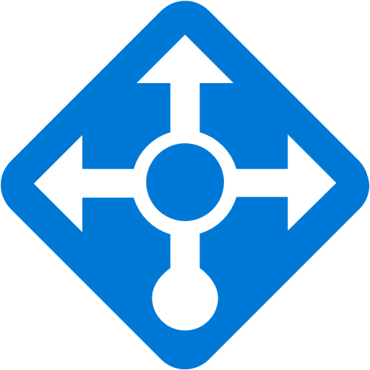
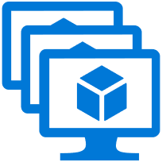
Service Fabric Managed Clusters in Azure
Service Fabric cluster
A Cluster supports 1,000s of nodes is self repairing, and scales-in and out
Load Balancer
VM Scale set
VM Scale set
VM Scale set

Slide 29
Service Fabric Managed Clusters in Azure
Service Fabric cluster
VM #2
Service Fabric
Your code, etc.
VM #3
Service Fabric
Your code, etc. (Port: 19080)
VM #1
Your code, etc.
Service Fabric
VM #4
Your code, etc.
Service Fabric
VM #5
Your code, etc.
Web Request Port: 80
Load Balancer
Service Fabric
Your code, etc.

Slide 30


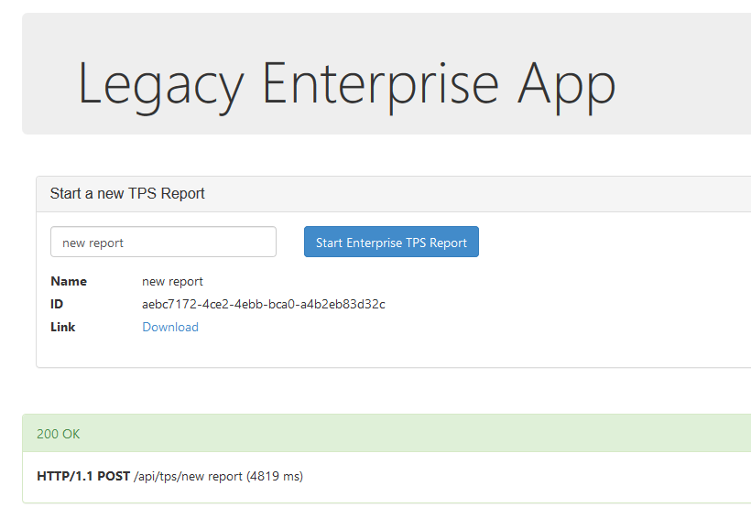
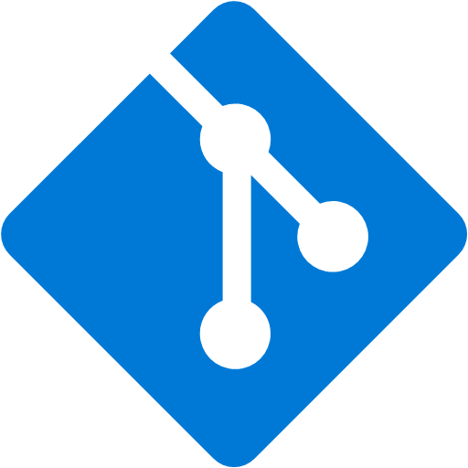
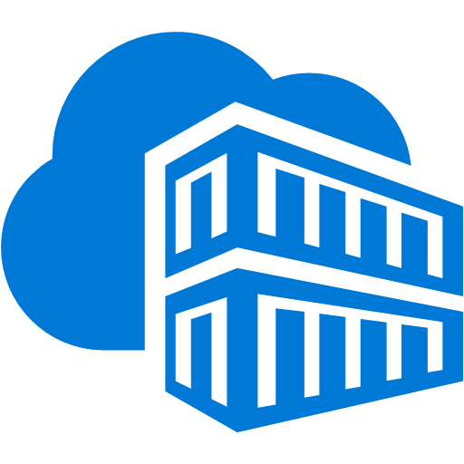

“Lift and Shift” existing applications to containers
Service Fabric cluster
Service Fabric Application Model or
Docker Compose
Front-end web service
container
Database Migration Service
Azure Repos Git Repository
Azure Container Registry
SQL Server

Slide 31


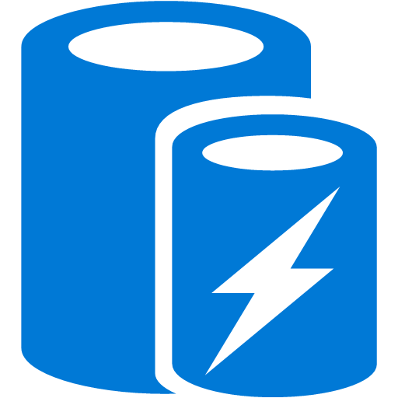

Stateless Services Pattern
Load Balancer
Scale stateless services backed by partitioned storage
Increase reliability and ordering with queues
Reduce read latency with caches
Manage your own transactions for state consistency
Front End
Gateway
Stateless
Middle-tier
Compute
Cache
Queues Storage

Slide 32

Stateful Services Pattern Simplify state, reduce latency
Load Balancer
Application state resides in the compute tier
Low latency reads and writes
Partitions are first class at the service layer for scale-out
Built in transactions
External stores for offline analytics
Front End
Gateway
Stateful
Middle-tier
Compute
Cold Data Stores

Slide 33
Azure Containers

Slide 34
Why containers? Benefits of a container architecture:
It’s repeatable and productive:
Containers present an immutable environment.
Reusable and portable code (“Build, Ship, and Run”).
It’s consistent across development, test & production.
It’s fast and efficient:
Fast & agile app deployment and instant startup.
Since containers do not require a separate operating system, they use less resources.
It’s cross-platform:
Build it once, run it anywhere: containers run on any cloud, without changes.
Containers support all frameworks and technology stacks.

Slide 35
What is Docker ?
World’s leading software container platform
Containers are isolated, but share operating system (OS) and, where appropriate, binaries and libraries.
Results in faster deployment, much less overhead, easier migration, and faster restart.
Notes:
Containers have similar resource isolation and allocation benefits as virtual machines but a different architectural approach allows them to be much more portable and efficient.
What is a container?
On the left side of the slide, there is a representation of a virtual machine environment.
We all understand how they work. They bring all guest operating systems with it. You get less densities and also slow start and stop because you have to load all the operating systems. You cannot start a VM in a second but you do get really good isolation. Each of those operating systems is almost completely isolated.
Containers, shown on the right side, are quite similar to VMs, but instead of the hypervisor, there is an engine that runs the containers. In this case, we talk about the Docker engine and the implementation of that.
On top, you have binaries and libraries and these can be shared across different containers. The application is what unique to your container. You get much more density because containers are smaller. We get slower stop and start time because they do not have a guest operating system. You have less isolation because these reach done into the host OS in order to be functional and if you break through the security of the container itself you’re actually in the kernel at that point. Less isolation, but more density more performance more agility.
Containers How do they differ from virtual machines?
Dependencies: Each virtualized app includes the app itself, required binaries and libraries, and a guest OS, which might consist of multiple gigabytes of data.
Independent OS: Each VM can have a different OS from other VMs, along with a different OS to the host itself.
Flexible: VMs can be migrated to other hosts to balance resource usage and for host maintenance without downtime.
Secure: High levels of resource and security isolation for key virtualized workloads.

Slide 36
Docker Terminology
Docker images are read-only templates used to create containers. Each image contains a set of instructions for creating the containers, such as what programs to install, what folders and files to create, what volumes to mount, what port numbers to expose, and so on
Docker Container is an isolated application platform. Containers are created from docker images.
Notes:
Docker Engine is the program that enables containers to be built, shipped, and run. It is also referred to as a Docker Daemon on Linux

Slide 37
Comparing Containers and VMs
Containers are separate but share OS and, where appropriate, binaries/libraries
App
A
App
A’
App
B
Bin/ Libs
Bin/ Libs
Bin/ Libs
VM
Guest
OS
Guest
OS
Guest
OS
App A
App A’
App B
App B’
App B’
App C
Container
Bin/Libs
Bin/ Libs
Bin/Libs
Hypervisor
Docker Engine
Host OS
Host OS
Server
Server
Notes:
Containers have similar resource isolation and allocation benefits as virtual machines but a different architectural approach allows them to be much more portable and efficient.
What is a container?
On the left side of the slide, there is a representation of a virtual machine environment.
We all understand how they work. They bring all guest operating systems with it. You get less densities and also slow start and stop because you have to load all the operating systems. You cannot start a VM in a second but you do get really good isolation. Each of those operating systems is almost completely isolated.
Containers, shown on the right side, are quite similar to VMs, but instead of the hypervisor, there is an engine that runs the containers. In this case, we talk about the Docker engine and the implementation of that.
On top, you have binaries and libraries and these can be shared across different containers. The application is what unique to your container. You get much more density because containers are smaller. We get slower stop and start time because they do not have a guest operating system. You have less isolation because these reach done into the host OS in order to be functional and if you break through the security of the container itself you’re actually in the kernel at that point. Less isolation, but more density more performance more agility.
Containers How do they differ from virtual machines?
Dependencies: Each virtualized app includes the app itself, required binaries and libraries, and a guest OS, which might consist of multiple gigabytes of data.
Independent OS: Each VM can have a different OS from other VMs, along with a different OS to the host itself.
Flexible: VMs can be migrated to other hosts to balance resource usage and for host maintenance without downtime.
Secure: High levels of resource and security isolation for key virtualized workloads.

Slide 38

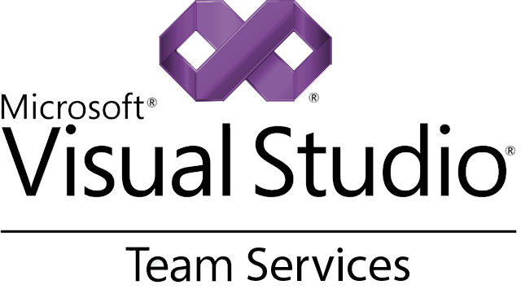
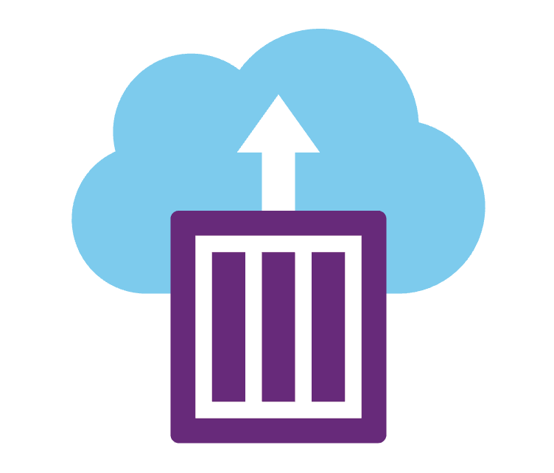
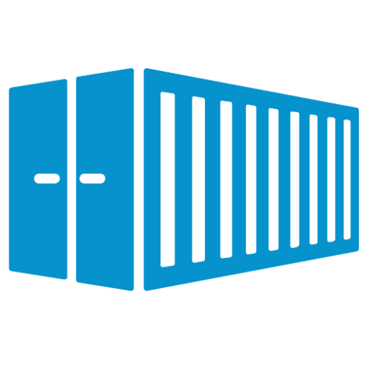
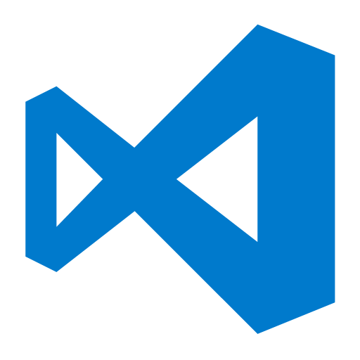

Microsoft Container Technologies
Azure App Service
Azure Container Instances
foo(bar) {
…
}
Azure Container Registry
Linux
Windows
Azure Service Fabric
Azure Kubernetes Service
Notes:
Pervasive
Take containers deploy them from one platform to another. So powerful
Have services to build and support containers natively.
Goal: customers can choose whatever platform they want, don't have to change your processes or tools. Containers everywhere

Slide 39
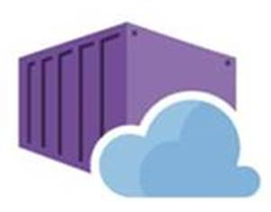
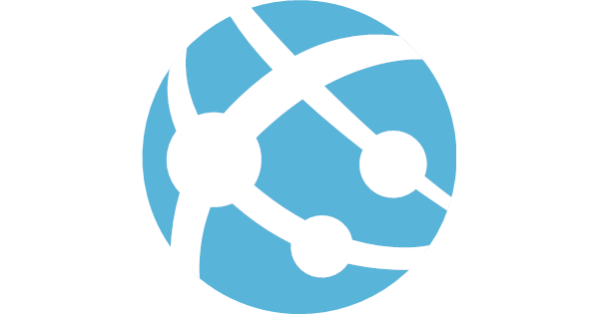




Web App comes to Linux (w/ container support)
Bring your code
Bring your containers
.NET Core
Web App for Containers
Deploy to Azure in seconds
Scale easily on demand
Designed for your agile web development needs

Slide 40
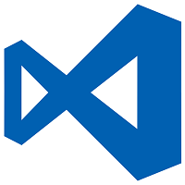


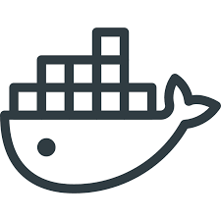



Deployment Life Cycle
VSCode
Github repos
ACR
Docker hub
Local Git repos
Developers
Redis cache
Web App for Containers
Azure database for MySQL
Monitoring log aggregation
CDN
End users

Slide 41
Debugging and Troubleshooting
SSH
Enable Diagnostics
Docker Logs
Server logs
Best practices for logging to custom docker images
Notes:
Sometimes last to talk about
One of the most important for developers

Slide 42
Kubernetes: the industry leading orchestrator
Portable
Public, private, hybrid, multi-cloud
Extensible
Modular, pluggable, hookable, composable
Self-healing
Auto-placement, auto-restart, auto-replication, auto-scaling

Slide 43
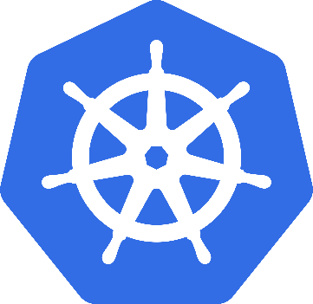
What is Kubernetes?
Background
"Kubernetes is an open-source system for automating deployment, scaling, and management of containerized applications”
Schedules and runs application containers across a cluster of machines
Kubernetes v1.0 released on July 21, 2015. Joe Beda, Brendan Burns, & Craig McLuckie
Key features
Declarative infrastructure
Self-healing
Horizontal scaling
Automated rollouts and rollbacks
Service discovery and load balancing
Automatic bin packing
Storage orchestration
Secret and configuration management
Not a PaaS platform

Slide 44


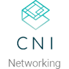








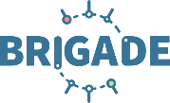


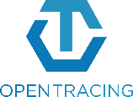







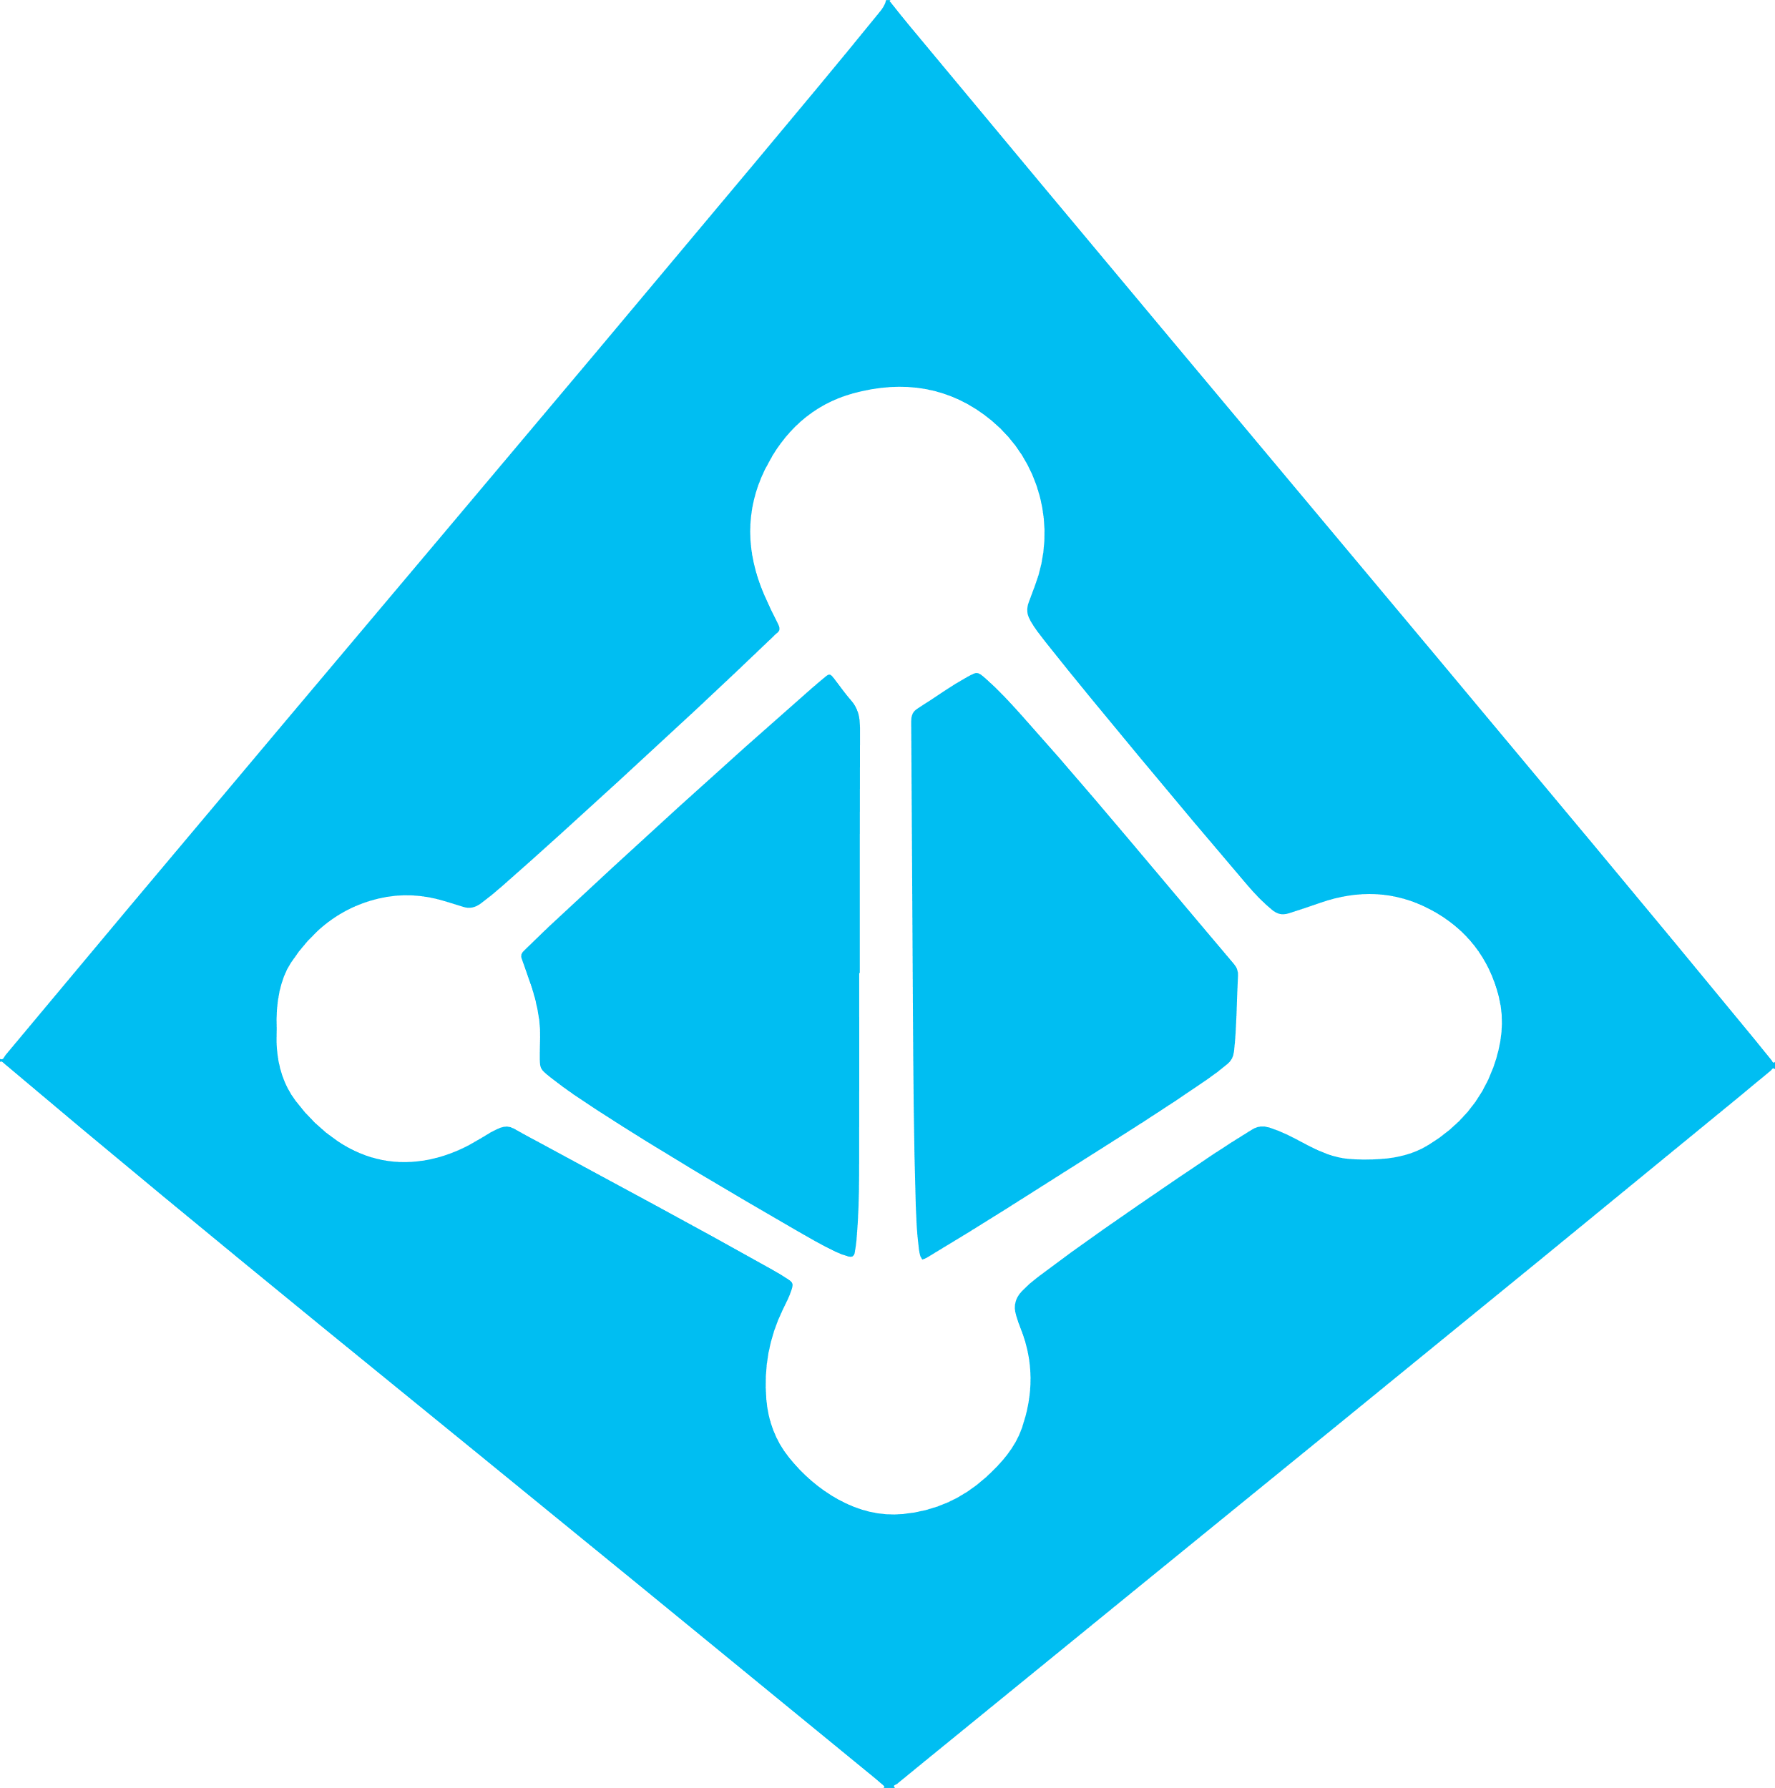
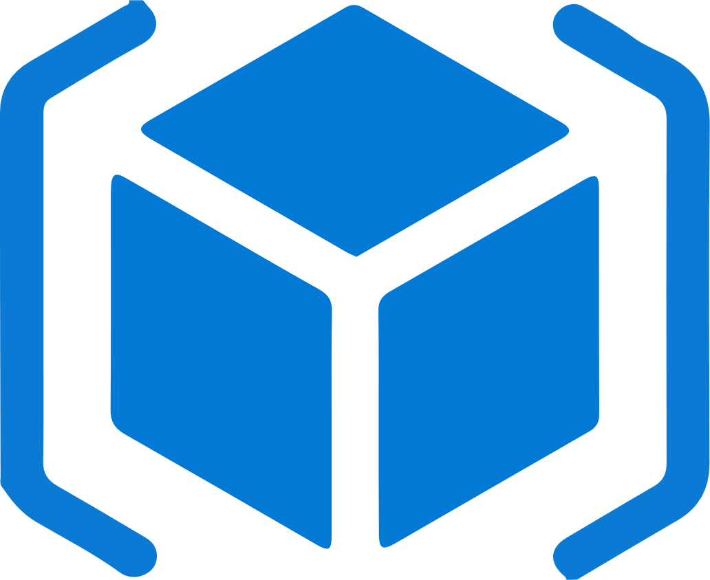

Work how you want with opensource tools and APIs
 | Development | DevOps | Monitoring | Networking | Storage | Security
Take advantage of services and tools in the Kubernetes ecosystem
OR, Leverage growing Azure support
RBAC
Azure Container Registry
AAD
Key Vault
VSTS
ARM
VS Code
Azure Monitor
Azure VNET
Azure Storage

Slide 45
Azure Dev Ops

Slide 46
What technologies do I need to support DevOps?
DevOps brings together people, processes, and technology, automating software delivery to provide continuous value to your users. Using Azure DevOps, you can deliver software faster and more reliably - no matter how big your IT department or what tools you’re using.
Continuous Integration (CI)
Improve software development quality and speed.
When you use Azure Pipelines or Jenkins to build apps in the cloud and deploy to Azure, each time you commit code, it’s automatically built and tested and bugs are detected faster.
Continuous Deployment (CD)
By combining continuous integration and infrastructure as code (IaC), you’ll achieve identical deployments and the confidence to deploy to production at any time.
With continuous deployment, you can automate the entire process from code commit to production if your CI/CD tests are successful.
Continuous Learning & Monitoring
With Azure Application Insights you can identify how your applications are performing and test if the recent deployment made things better or worse.
Using CI/CD practices, paired with monitoring tools, you’ll be able to safely deliver features to your customers as soon as they’re ready.

Slide 47
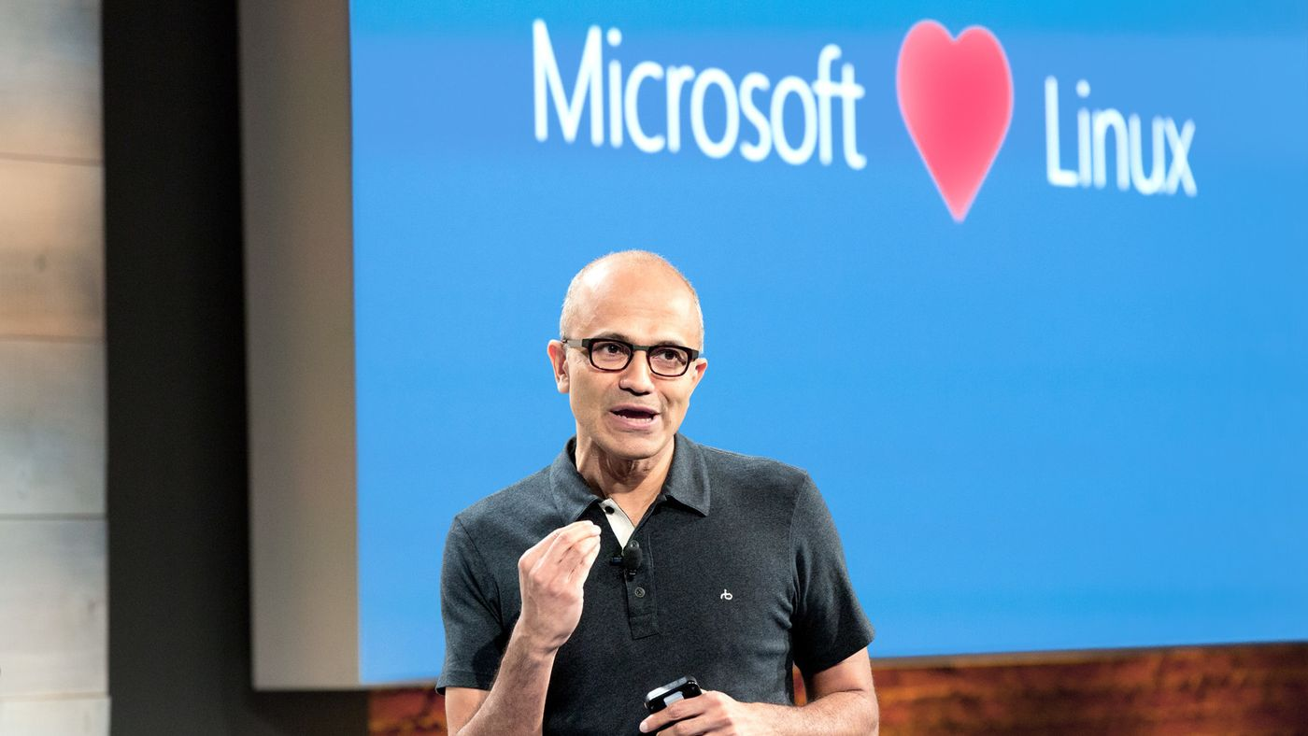

Microsoft Open Source
2018
Visual Studio Code ranked #1 developer tool
Azure Service Fabric Open Sourced
Azure Sphere with Linux kernel
Intent to acquire GitHub announced
~5,000 Microsoft employees committing to open source projects on GitHub
Azure trending to 50% Linux
Microsoft continues as largest contributor to open source projects on GitHub
“Judge us by the actions we have taken in the recent past, our actions today and in the future”
—Satya Nadella, CEO Microsoft
2017
Microsoft Azure Kubernetes Service launched
Draft, Brigade, Kashti projects submitted to Kubernetes community
Microsoft joins Cloud Native Computing & Cloud Foundry Foundations
SQL 2017 on Linux
Windows source code moved to Git
Azure Databricks (Apache Spark) announced
2016
.NET Core 1.0
PowerShell Core
Windows Subsystem for Linux in Windows 10
Microsoft joins Linux Foundation
GitHub recognizes Microsoft as a top open source contributor
2015
Visual Studio Code released
HDInsight (Hadoop/ Ubuntu) announced
Microsoft jointly forms Node.js foundation
2014
Satya “Microsoft loves Linux”
Microsoft org on GitHub created
.NET Foundation created
2012
TypeScript released
Git support added to TFS and Visual Studio
2012
2014
2015
2016
2017
2018
Notes:
& at Microsoft we love open source.
Every year we do more & more in the open source realm.
How we embrace the projects the community has embraced… from Linux to Kubernetes.
One of the ones I was deeply involved in was whether to compete with Git or become part of it. Today most of MS development is done in Git. The source control system that Linux created.
Including Windows. Think about that for a second, the Windows team use the source control system written by Linus Torvalds.
Or the ways we increasingly open source the software we work on… from .NET to VS Code & TypeScript. In fact, much of the core tech in Azure Pipelines itself is open source
Transition:
This week we are adding to this list…
Backup:
First OSS project was in 2004 when the Windows Installer Toolkit (WiX) was released to SourceForge.
Started contributing to the Linux kernel in 2009

Slide 48

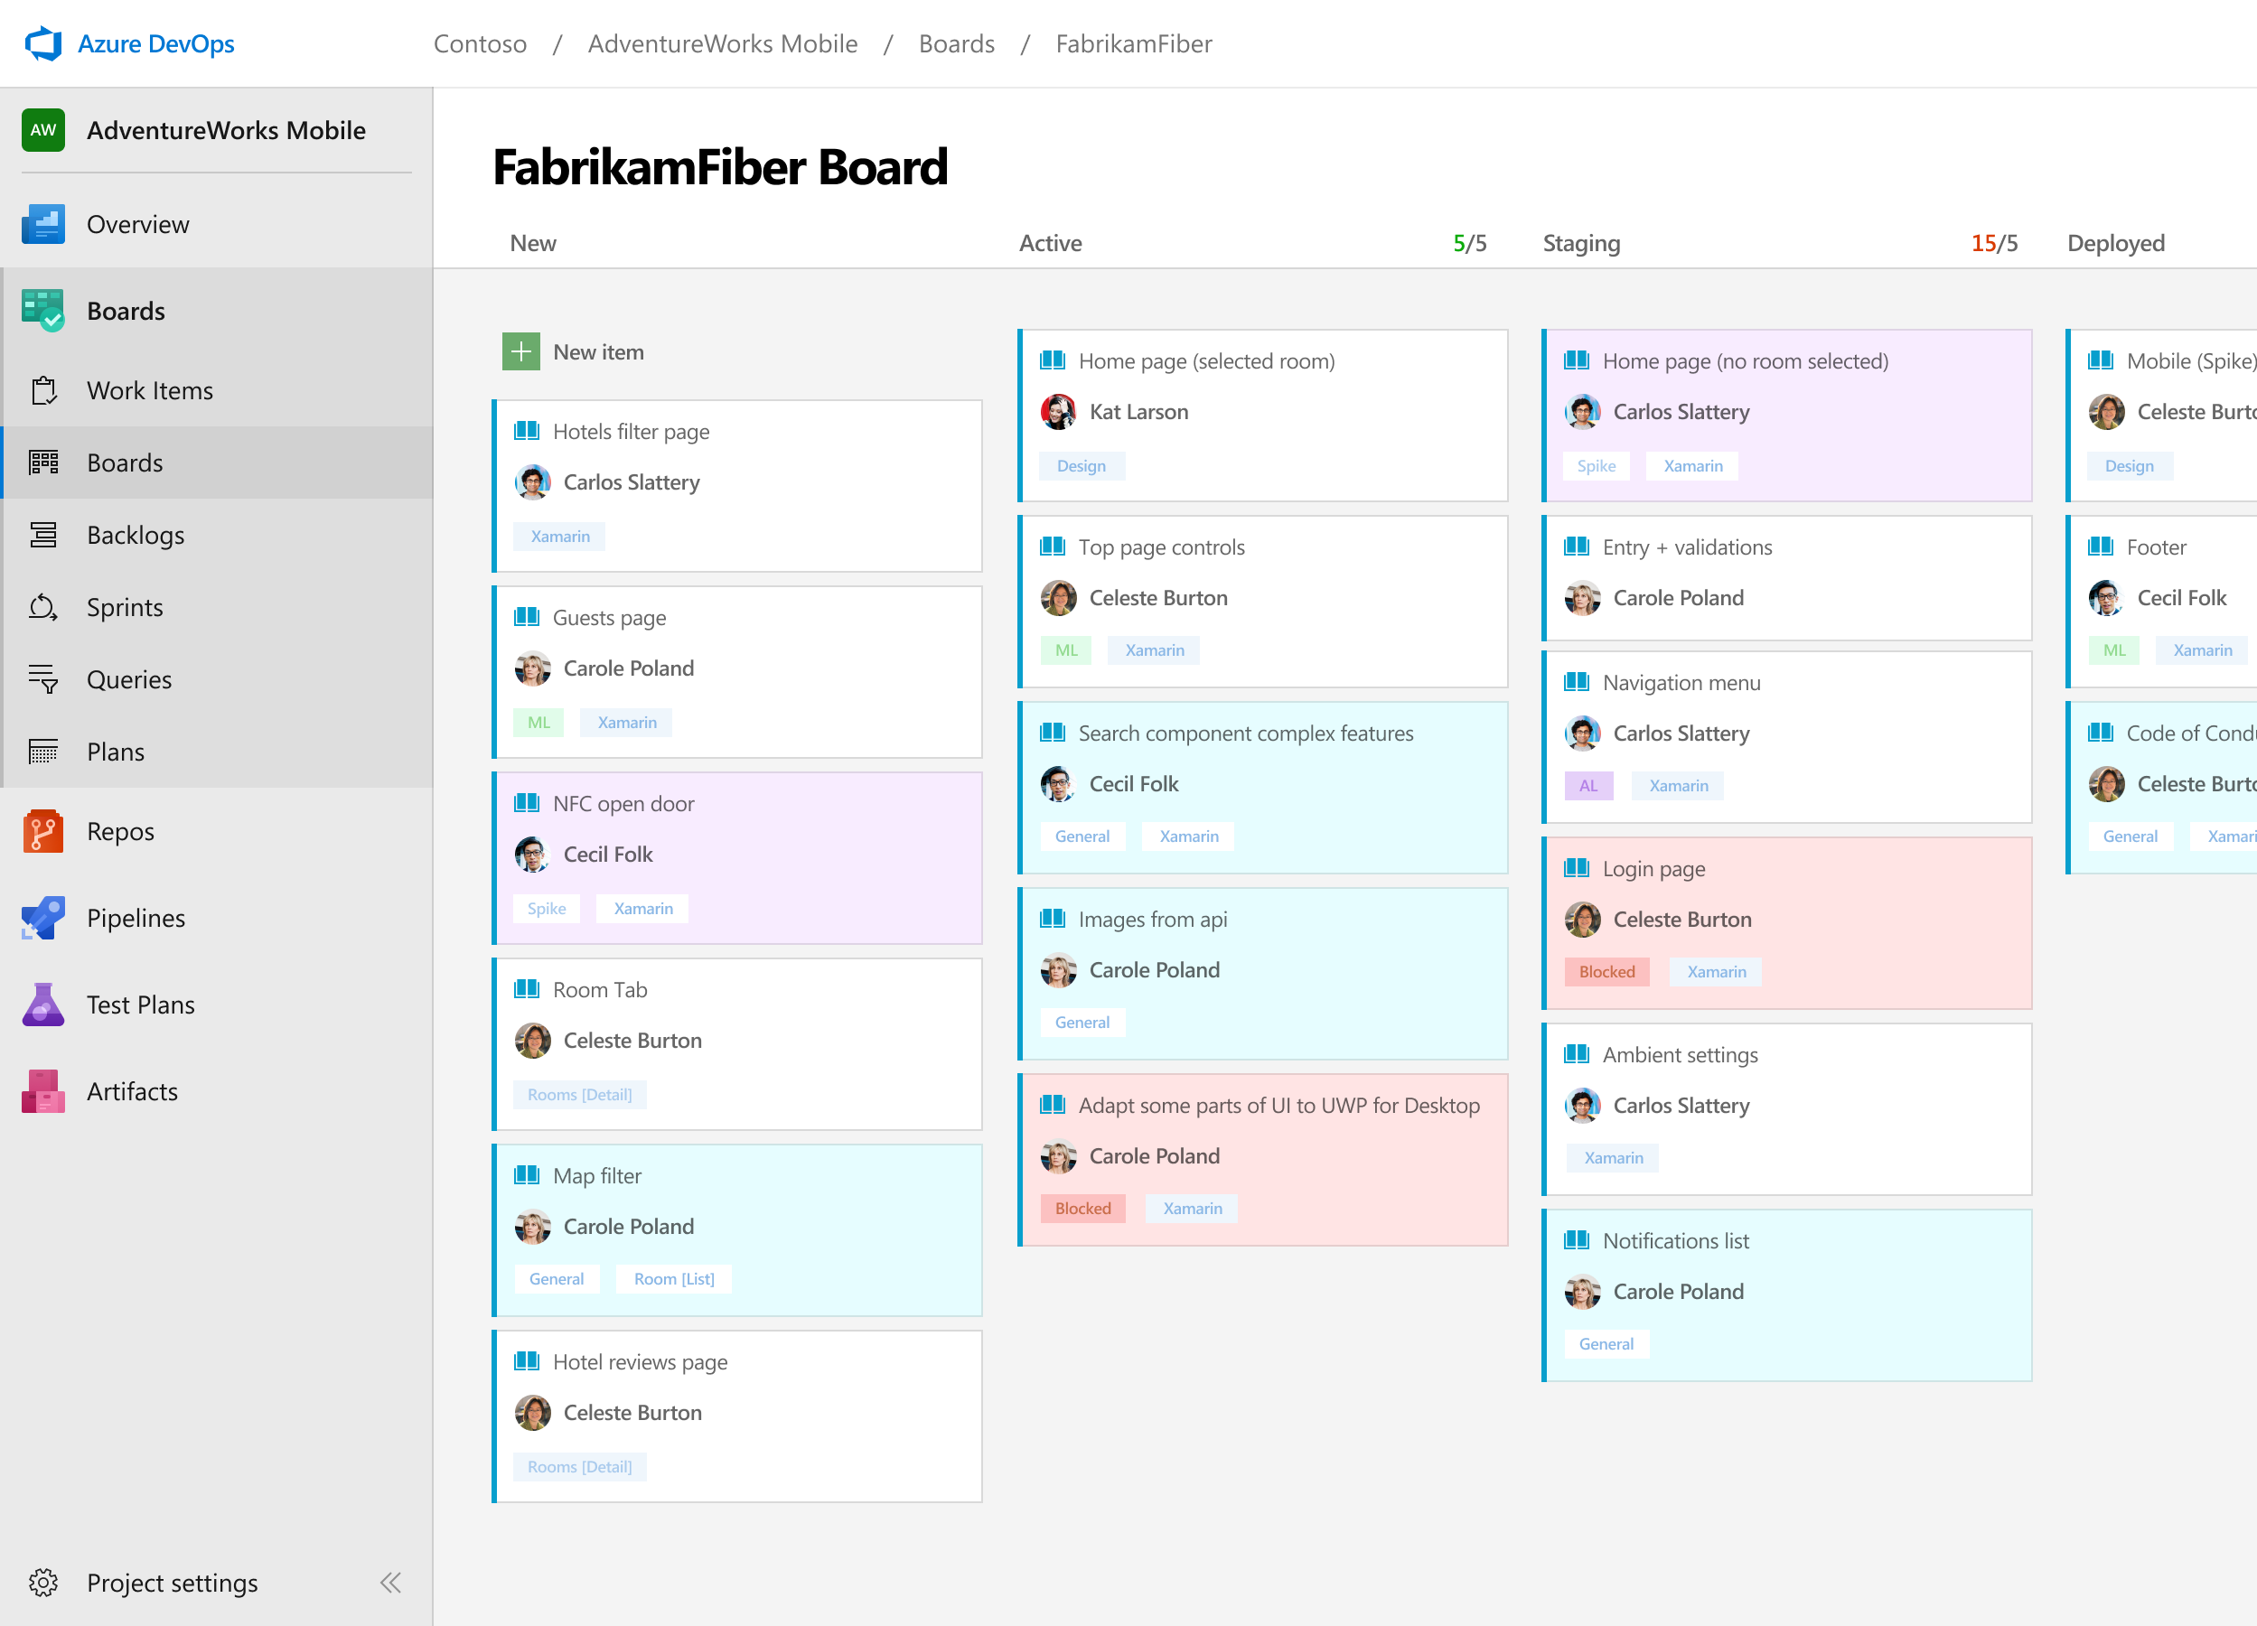



Azure Boards
Track work with Kanban boards, backlogs, team dashboards, and custom reporting
Connected from idea to release
Track all your ideas at every development stage and keep your team aligned with all code changes linked directly to work items.
Scrum ready
Use built-in scrum boards and planning tools to help your teams run sprints, stand-ups, and planning meetings.
Project insights
Gain new insights into the health and status of your project with powerful analytics tools and dashboard widgets.
➔
https://azure.com/devops
Notes:
Combine Kanban boards and drag-and-drop sprint planning with comprehensive traceability and reporting for the perfect home for all your ideas–big and small.

Slide 49
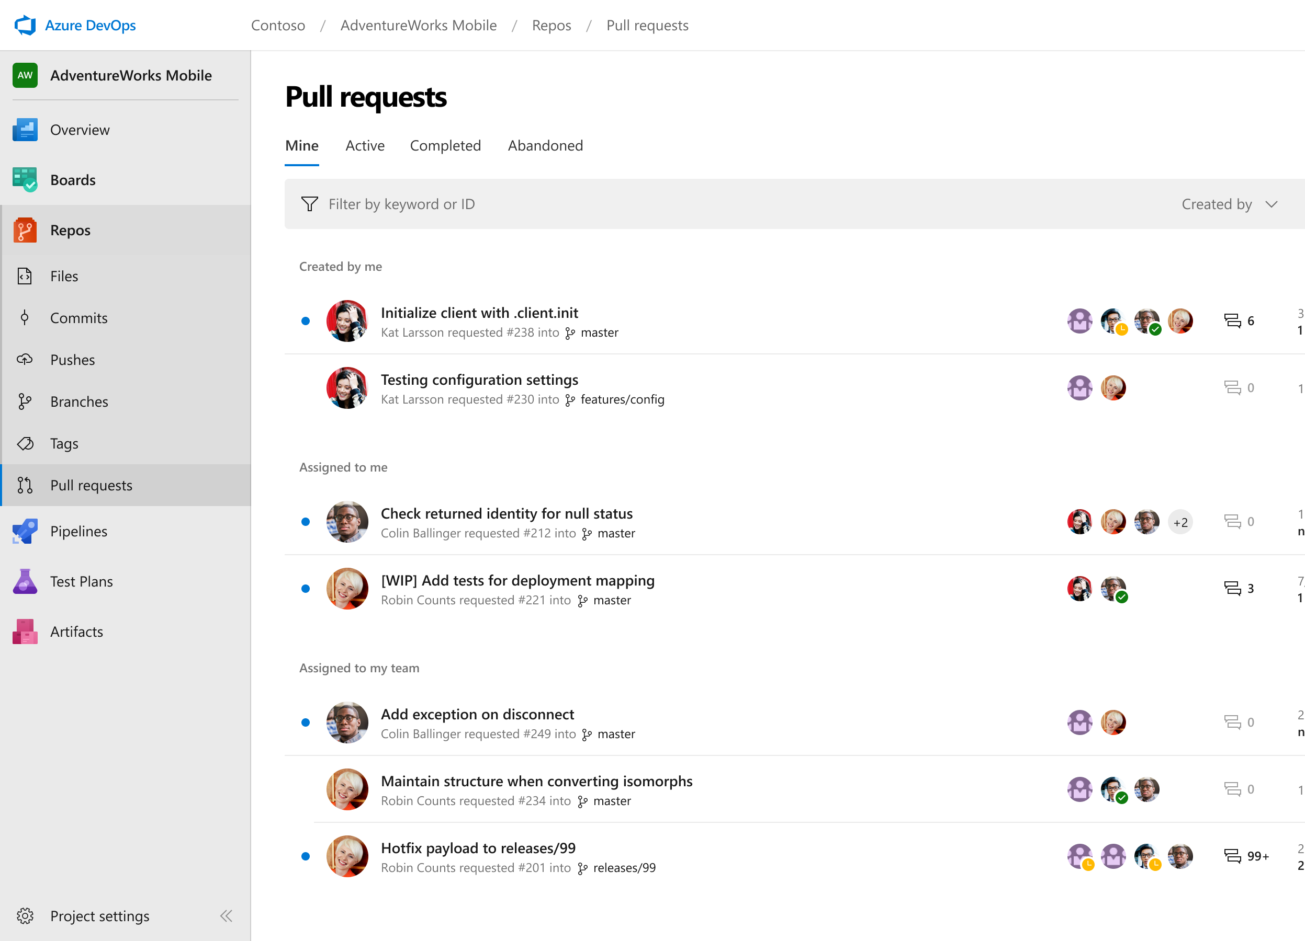



Azure Repos
Unlimited private Git repo hosting and support for TFVC that scales from a hobby project to the world’s largest Git repositories
Works with your Git client
Securely connect with and push code into your Git repos from any IDE, editor, or Git client.
Web hooks and API integration
Add validations and extensions from the marketplace or build your own using web hooks and REST APIs.
Semantic code search
Quickly find what you’re looking for with code-aware search that understands classes and variables.
➔
https://azure.com/devops
Notes:
Collaborate on code changes with threaded discussion and continuous integration for each change. Use forks to promote collaboration with Inner Source workflows.

Slide 50
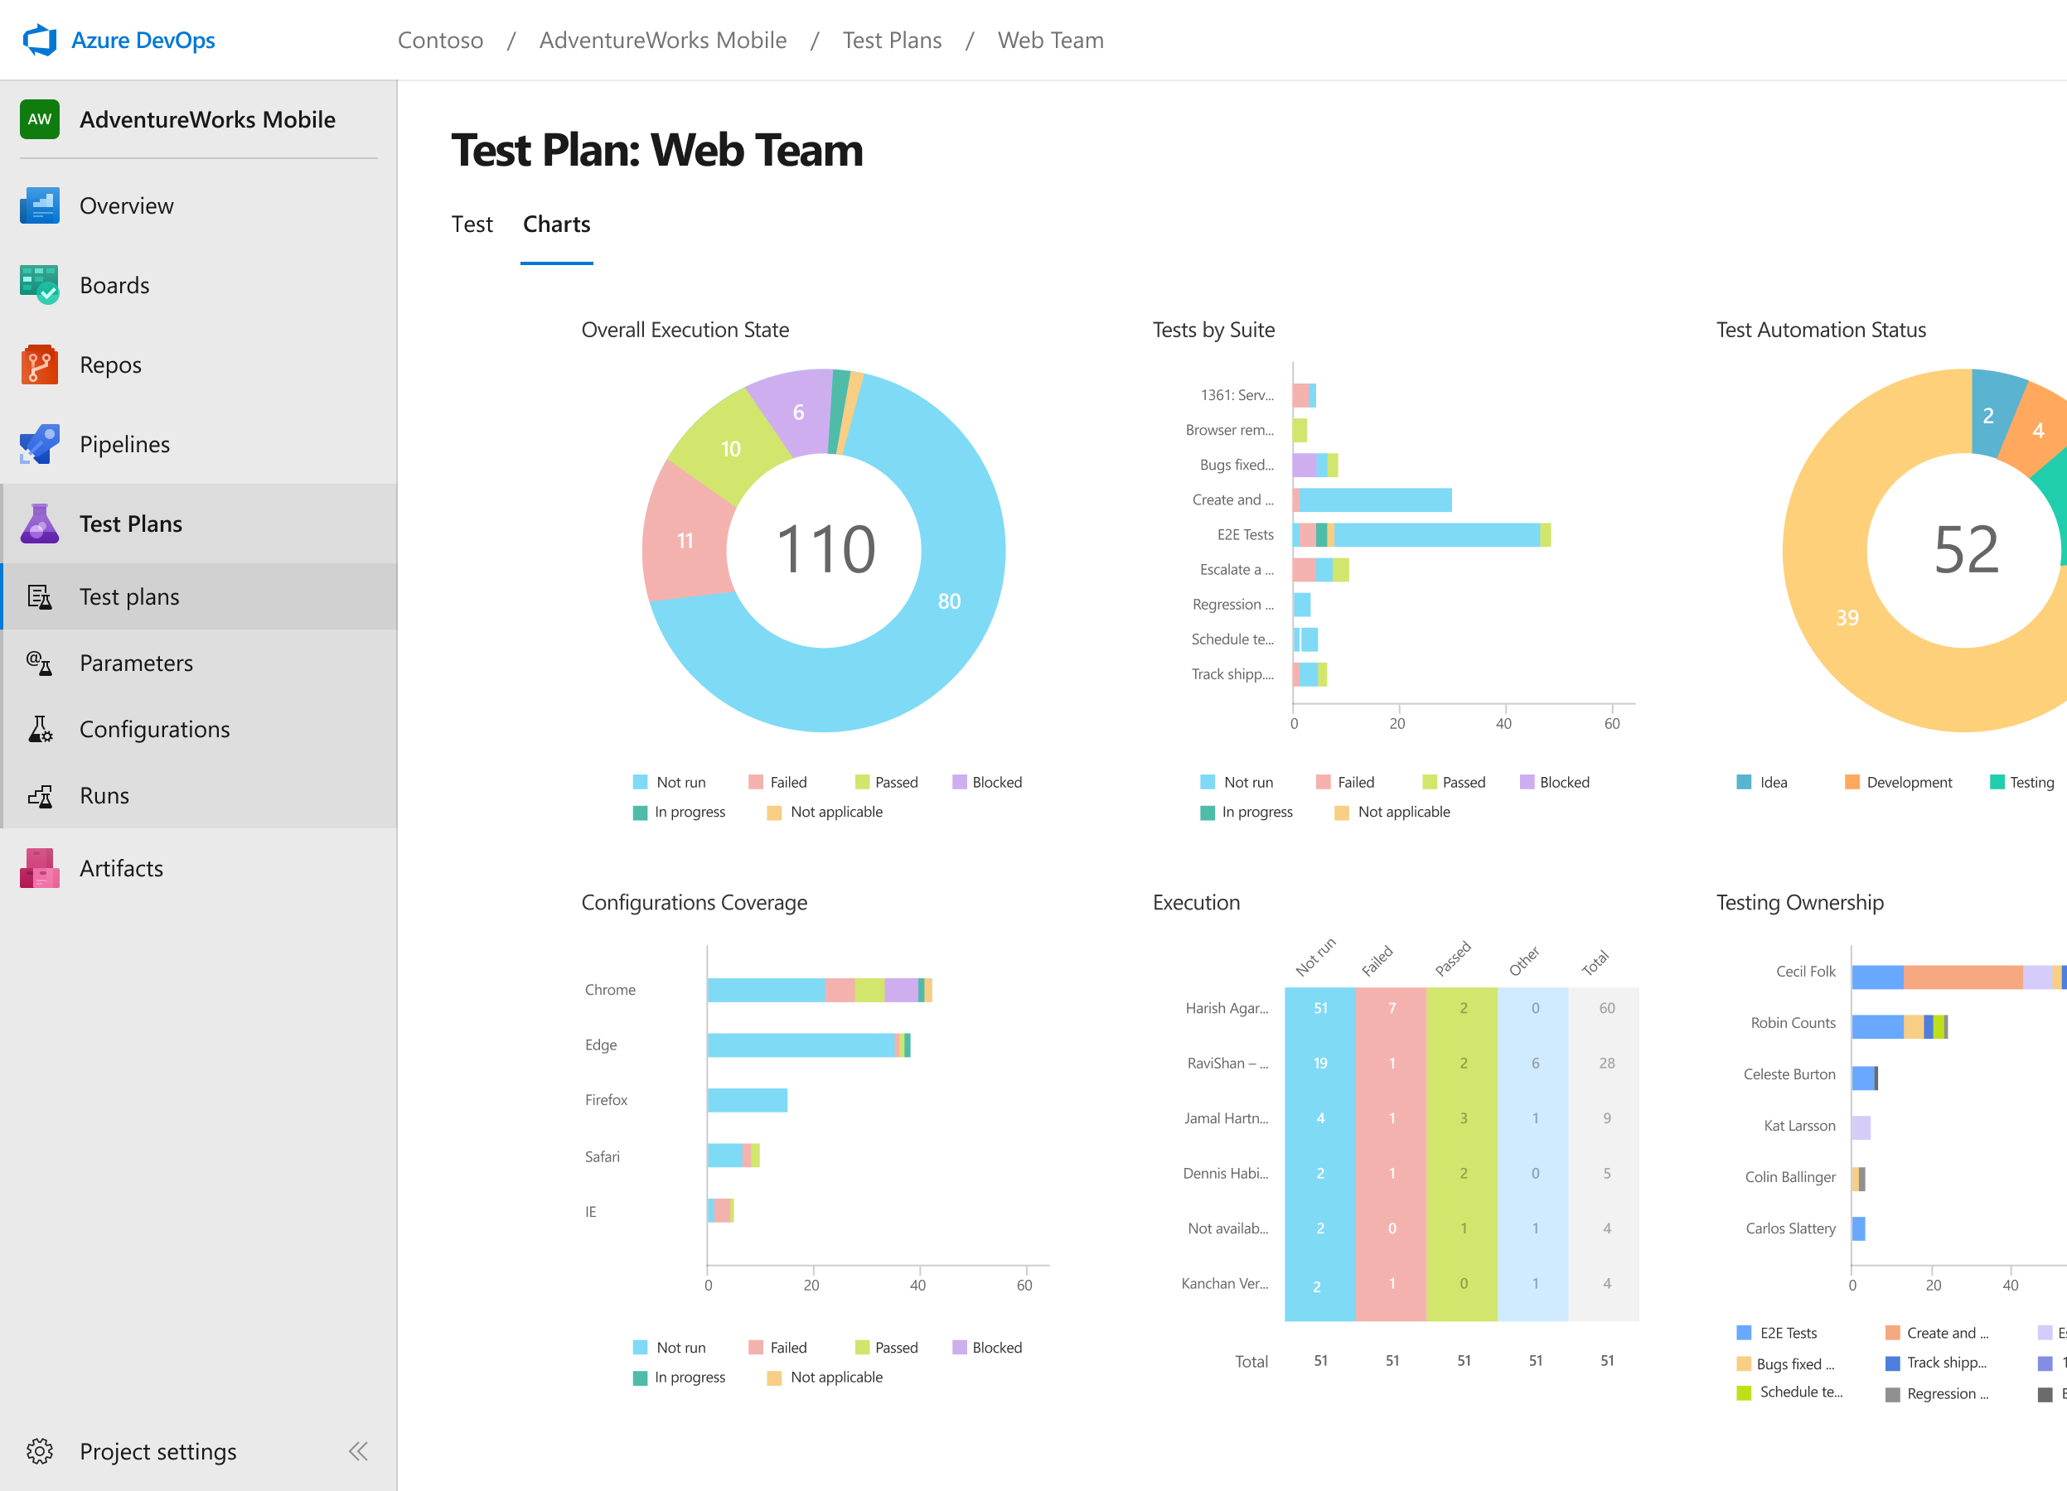



Azure Test Plans
Get end-to-end traceability. Run tests and log defects from your browser. Track and assess quality throughout your testing lifecycle.
Capture rich data
Capture rich scenario data as you execute tests to make discovered defects actionable. Explore user stories without test cases or test steps. You can create test cases directly from your exploratory test sessions.
Test across web and desktop
Test your application where it lives. Complete scripted tests across desktop or web scenarios. Test on-premises application from the cloud and vice-versa.
Get end-to-end traceability
Leverage the same test tools across your engineers and user acceptance testing stakeholders. Pay for the tools only when you need them.
➔
https://azure.com/devops
Notes:
Collaborate on code changes with threaded discussion and continuous integration for each change. Use forks to promote collaboration with Inner Source workflows.

Slide 51
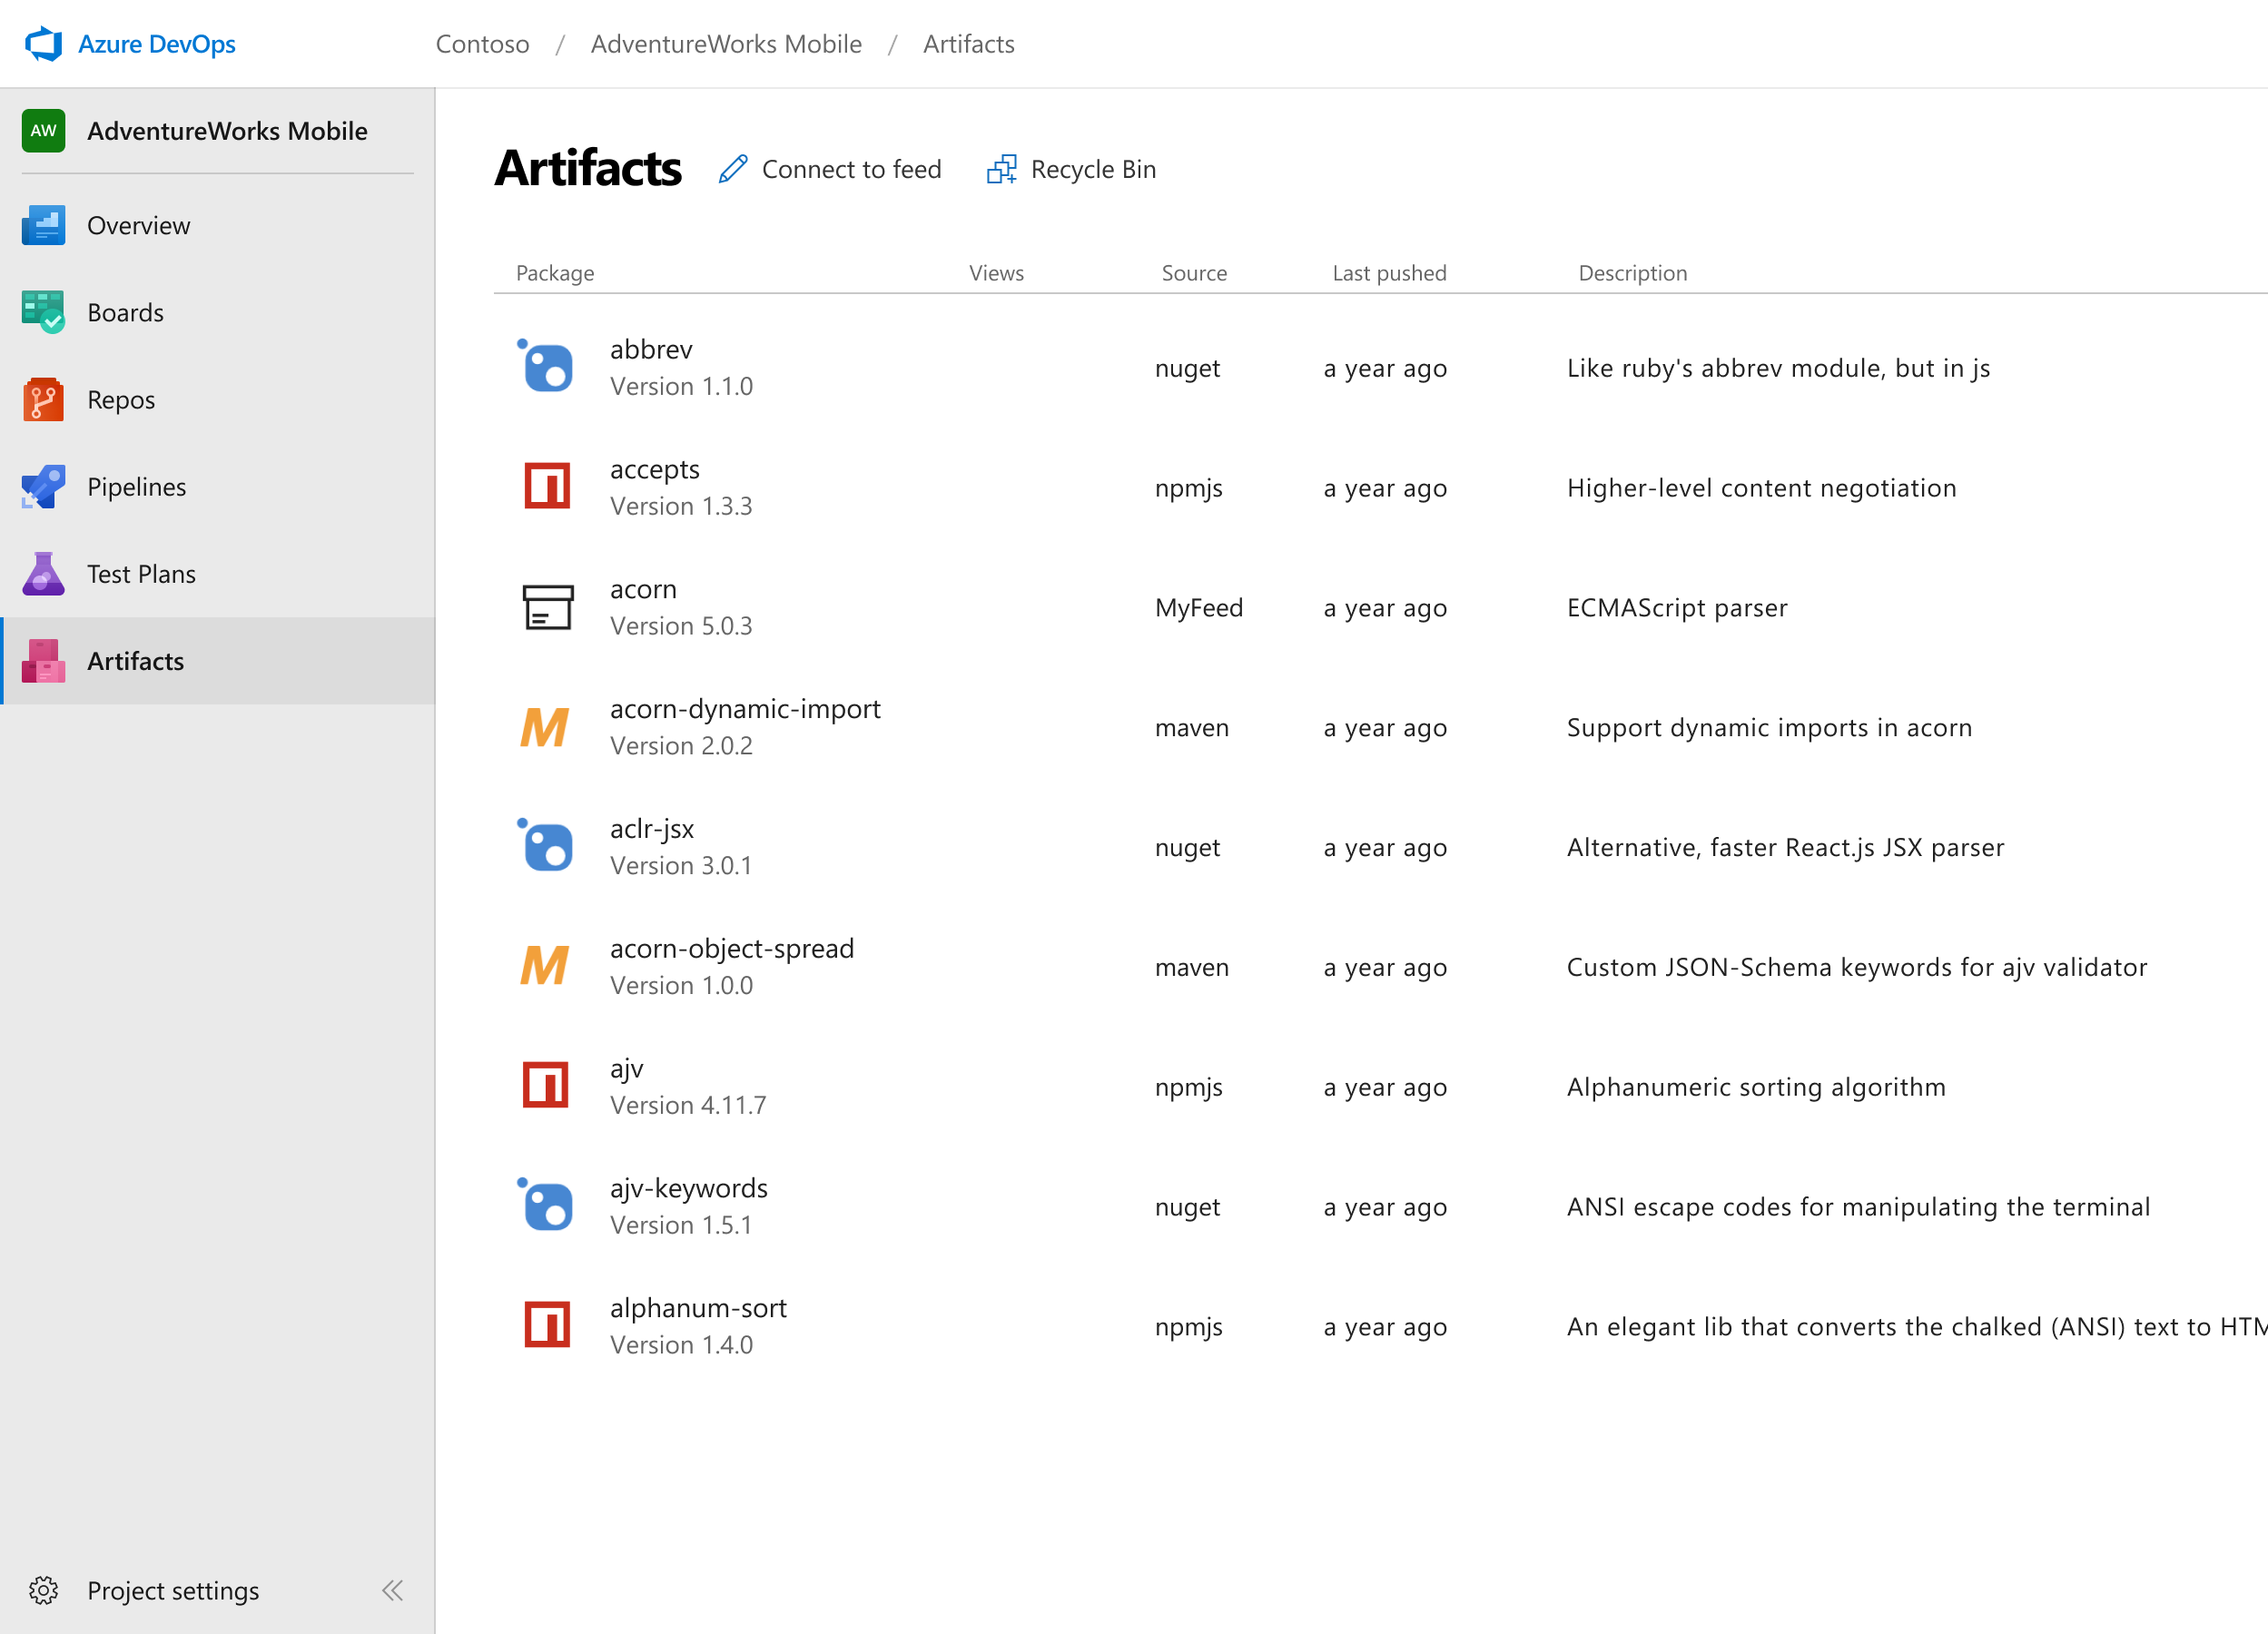



Azure Artifacts
Create and share Maven, npm, and NuGet package feeds from public and private sources – fully integrated into CI/CD pipelines
Manage all package types
Get universal artifact management for Maven, npm, and NuGet.
Add packages to any pipeline
Share packages, and use built-in CI/CD, versioning, and testing.
Share code efficiently
Easily share code across small teams and large enterprises.
➔
https://azure.com/devops
Notes:
Collaborate on code changes with threaded discussion and continuous integration for each change. Use forks to promote collaboration with Inner Source workflows.

Slide 52

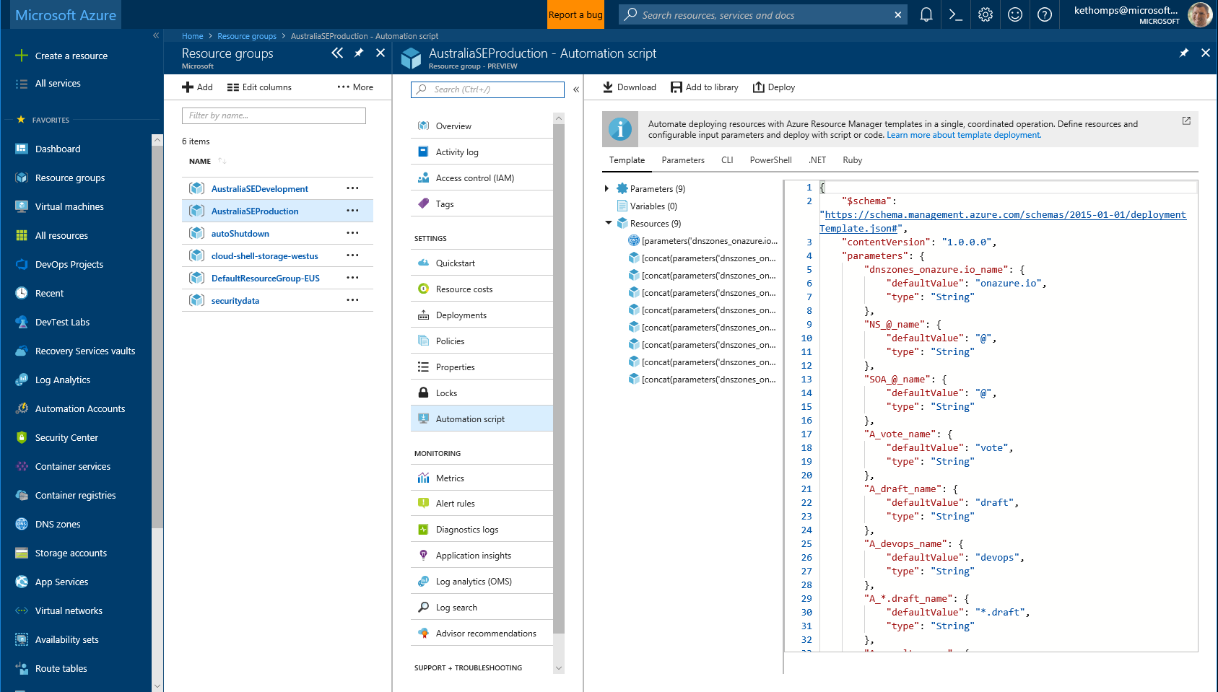
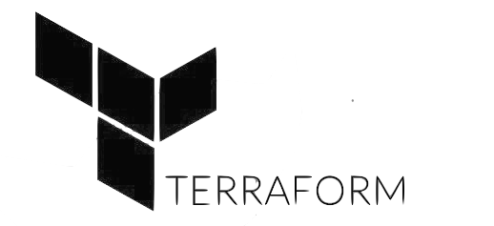


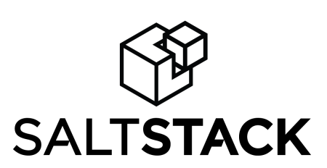

Infrastructure and Configuration as Code
Azure Resource Manager, Automation & 3rd Party Integrations
Infrastructure as Code, built-in
Azure Config & Automation
Support for 3rd party and OSS tooling such as Terraform, Ansible, Chef, Puppet & SaltStack
Notes:
Deploy repeatedly & reliably using Infrastructure as Code
Azure Resource Manager provides these capabilities for Azure out of the box, and works across Azure as well as Azure Stack
But if you’re already using 3rd party tools such as Terraform, Ansible, Chef, Puppet or SaltStack – we support those too!

Slide 53
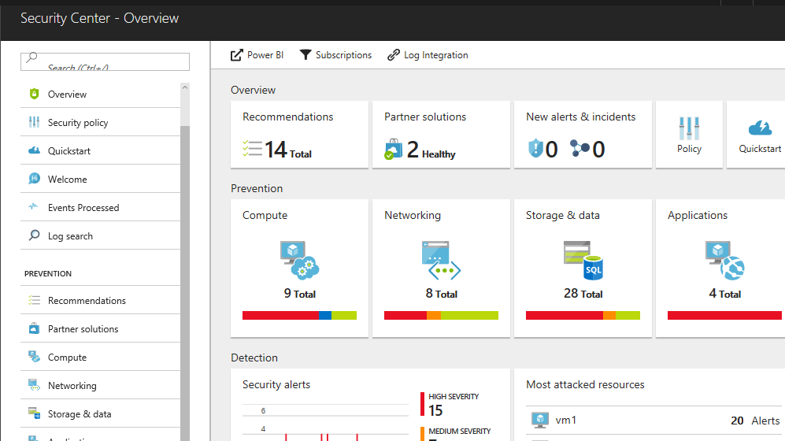
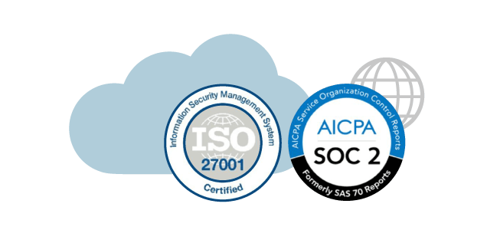
Continuous Security
Azure Security Center
Gain full visibility and control of your cloud security state
Leverage ML to Proactively identify and mitigate risks to reduce exposure to attacks
Quickly detect and respond to threats with advanced analytics
Notes:
Just because you’re moving fast, doesn’t mean you have to lose control – even if you have some Shadow-Ops happening
Azure security gives you visibility and control of your entire cloud security state
Using analytics to provide pro-active recommendations across both Windows and Linux
Leverage services like Azure Event Viewer also to track access, see who change what and when.
------ (additional product context) ------
Secure your cloud resources with Azure Security Center
With Azure Security Center you can gain full visibility and control of your cloud security state with a single, unified view:
Collect security data from multiple sources: Collect, search, and analyze security data from a variety of sources, including connected partner solutions like network firewalls and other Microsoft services.
Integration with existing security workflows: Access, integrate, and analyze security information using REST APIs to connect existing tools and processes.
Easily onboard cloud resources: Keep pace with rapidly changing cloud workloads. Automatically discover and onboard new resources created in your Azure subscriptions.
Continuous security assessment: monitor the security of virtual machines, networks, and Azure services using hundreds of built-in security assessments or create your own.
Built-in dashboards provide instant insights into security issues that require attention.
Centralized policy management: Ensure compliance with company or regulatory security requirements by centrally managing security policies across all your cloud workloads.
Compliance reporting: Use security data and insights to demonstrate compliance and easily generate evidence for auditors.
(If asked whether Azure Security Center supports hybrid workloads, the answer is yes: manage security across all your hybrid cloud workloads – on-premises, Azure, and other cloud platforms – in one console.)
You can also identify and mitigate risks proactively to reduce your exposure to security threats:
Proactive security assessment: Identify software and configurations that are vulnerable to attack.
Actionable recommendations: Remediate security vulnerabilities before they can be exploited by attackers with prioritized, actionable security recommendations and built-in automation playbooks.
Adaptive application controls: Block malware and other unwanted applications by applying whitelisting recommendations adapted to your specific workloads and powered by machine learning.
Controlled network access: Reduce the network attack surface with just-in-time, controlled access to management ports on Azure VMs, drastically reducing exposure to brute force and other network attacks.
Azure Security Center has robust capabilities to prevent attacks. When threats do happen, Security Center can quickly detect and respond to threats with advanced analytics and Microsoft Intelligent Security Graph.
Industry’s most extensive threat intelligence: Tap into the Microsoft Intelligent Security Graph, which uses trillions of signals from Microsoft services and systems around the globe to identify new and evolving threats.
Advanced threat detection: Use built-in behavioral analytics and machine learning to identify attacks and zero-day exploits. Monitor networks, machines, and cloud services for known attack patterns and post-breach activity.
Prioritized alerts and incidents: Focus on the most critical threats first with prioritized security alerts and incidents that map alerts of different types into a single attack campaign. Create your own custom security alerts as well.
Streamlined investigation: Quickly assess the scope and impact of an attack with a visual, interactive experience. Use predefined or ad hoc queries for deeper exploration of security data.
Contextual threat intelligence: Visualize the source of attacks on an interactive world map. Use built-in threat intelligence reports to gain valuable insight into the techniques and objectives of known malicious actors.
At Microsoft, we analyze 300 billion user authentications and check 200 billion emails for spam and malware monthly. We also have unprecedented visibility into cloud infrastructure choices, platforms and the activity therein. Such visibility has no precedent in the on-premises world.

Slide 54









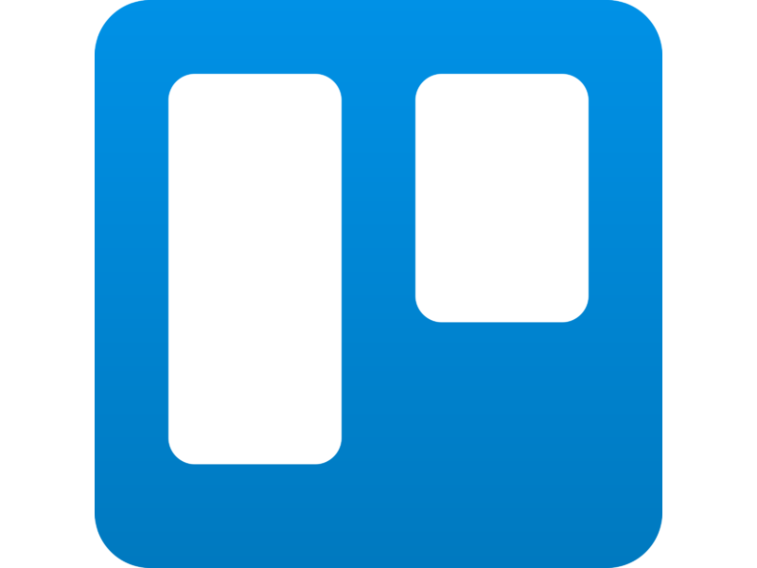


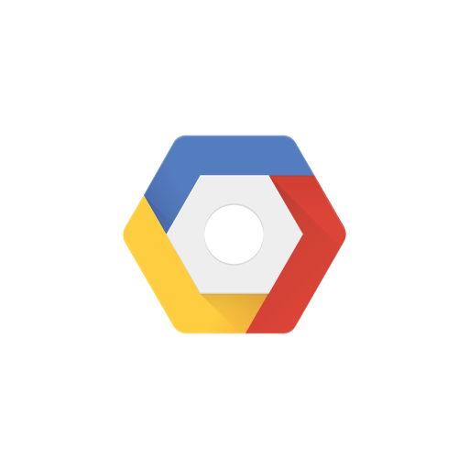
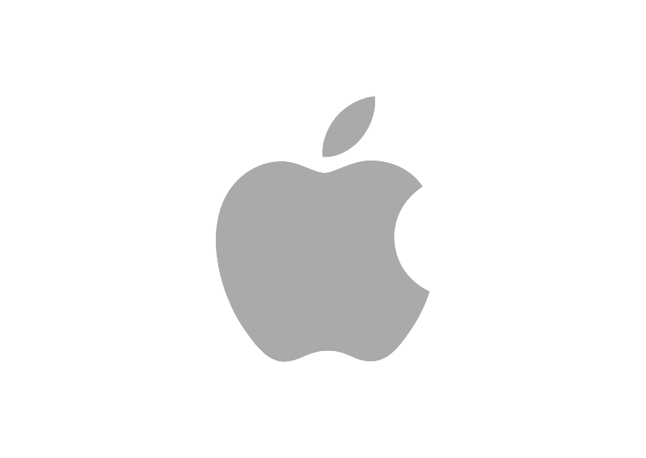


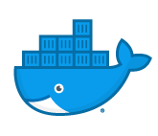
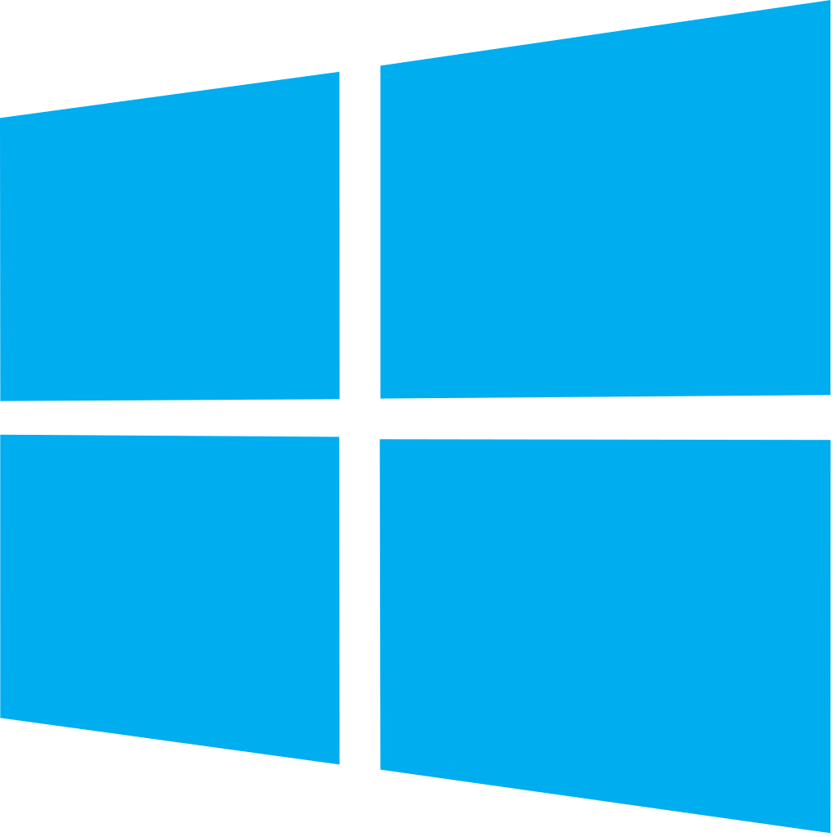


Azure DevOps: Choose the tools and clouds you love
Azure DevOps lets developers choose the tools that are right for them
Mix and match to create workflows with tools from Microsoft, open source or your favorite 3rd party tools
Target any cloud, on-prem or both and deploy to the servers you need

Slide 55
DevOps at Microsoft
Azure DevOps is the toolchain of choice for Microsoft engineering with over 90,000 internal users
➔
https://aka.ms/DevOpsAtMicrosoft
372k
Pull Requests per month
4.4m
Builds per month
5m
Work items viewed per day
78,000
Deployments per day
2m
Git commits per month
500m Test executions per day
500k
Work items updated per day
Data: Internal Microsoft engineering system activity, August 2018
Notes:
Enterprise scale

Slide 56

DevOps Pipelines in Minutes
Azure DevOps Projects
Create a full DevOps pipeline with 3 easy steps from the Azure Portal
Start with a Git repo and any source language
Web apps, Kubernates, soon VMs and more.
Customize, extend and scale when needed.
Notes:
Moving from the developer environment, Azure also makes deploying, or integrating existing, DevOps pipelines as fast as possible
Azure DevOps Projects is the quickest way to get started with DevOps on Azure for people who know about DevOps but are just starting or want a quick way to create a basic pipeline to play with or build upon.
DevOps projects creates a basic, complete CI/CD pipeline in Azure which can later be extended and customized outside in Azure Pipelines
Although DevOps Projects builds a DevOps pipeline on Azure it allows for any easy “Getting started” experience with Azure Pipelines which can then be applied to hybrid and on-prem scenarios with Azure Pipelines which can target any platform or with Azure DevOps Server which can be installed on prem.

Slide 57
Questions

